Slide 1
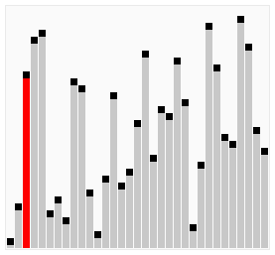
A longer example for Bubble Sort

Slide 2
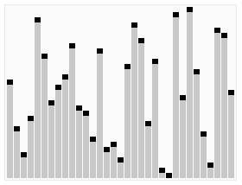
A longer example for Quick Sort

